Slide 1
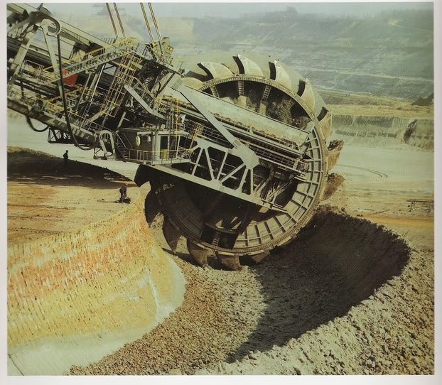
Demystifying Big Data
Jonathan Mills

Slide 2


































Platinum Sponsors
Gold Sponsors
Silver Sponsors

Slide 3
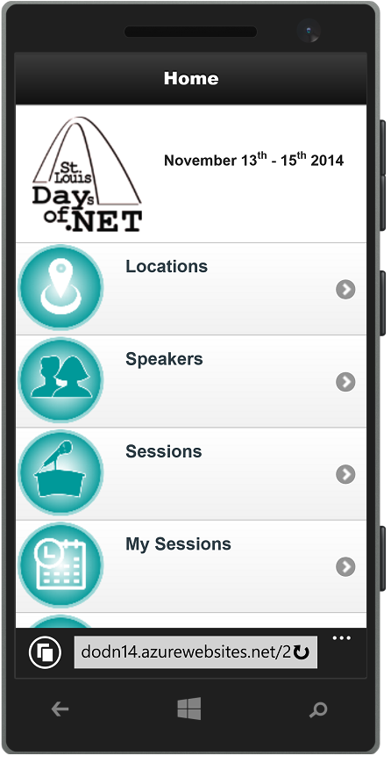
Conference Mobile App
dodn14.azurewebsites.net
Quick access to conference info
Build your custom agenda
Anonymously rate the sessions you attended
Share with the Twitter-verse

Slide 4
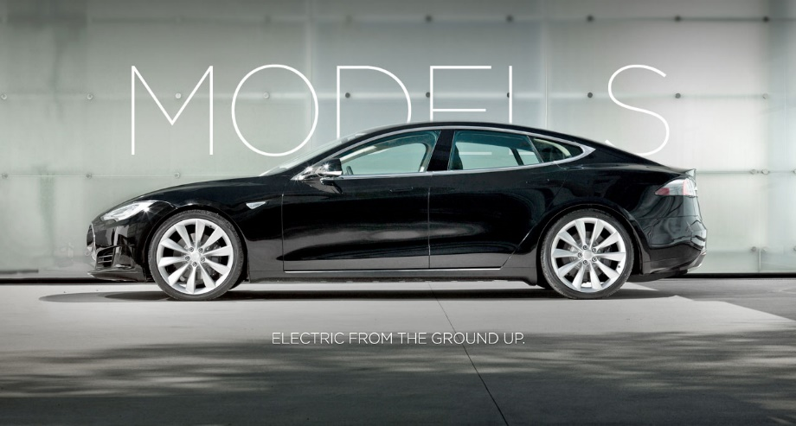
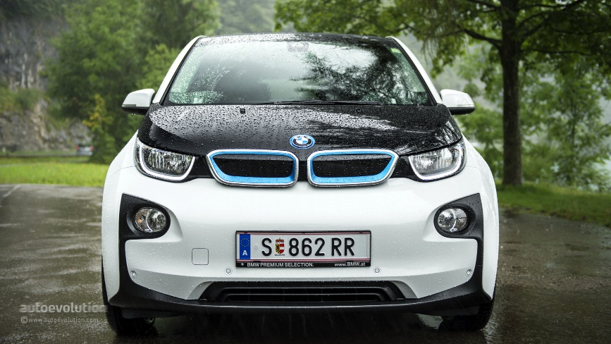
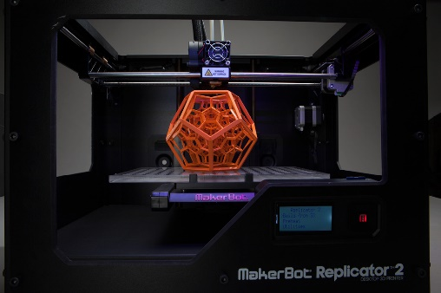

Fun Stuff Downstairs

Slide 5

Who Is This Guy?
Director R&D @ Paige Technologies
@jonathanfmills
Jonathanfmills.com
Notes:
A little about me
As a manager, I should not have to supervise the work of others……
As a manager, I am responsible for making the team the most efficient team they can be
Over the long term… Sticks don’t work over long term
Make sure they want to come to work every morning
Make sure they feel appreciated.

Slide 6
Big data is like teenage sex: everyone talks about it, nobody really knows how to do it,
everyone thinks everyone else is doing it, so everyone claims they are doing it...

Slide 7
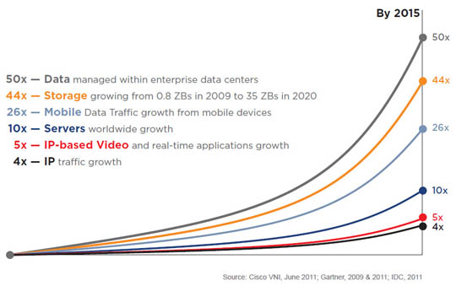
Why Big Data?
Notes:
Its not just that the data is there, you want to be able to DO something with it.

Slide 8



Slide 9
Slq Server can handle databases over 3 PB

Slide 10


Slide 11
Big Table
DynamoDB

Slide 12

What Is Big Data?

Slide 13
V
V
V

Slide 14
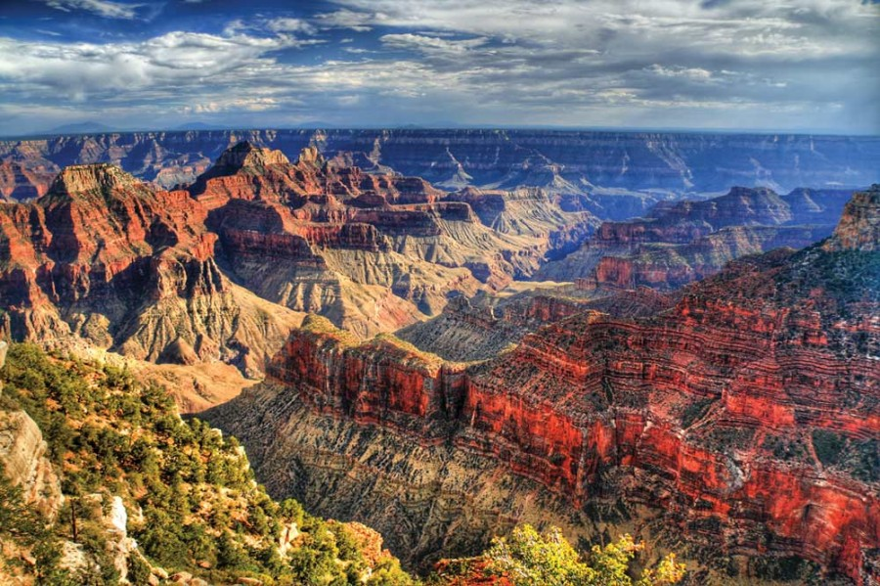
Volume
….

Slide 15
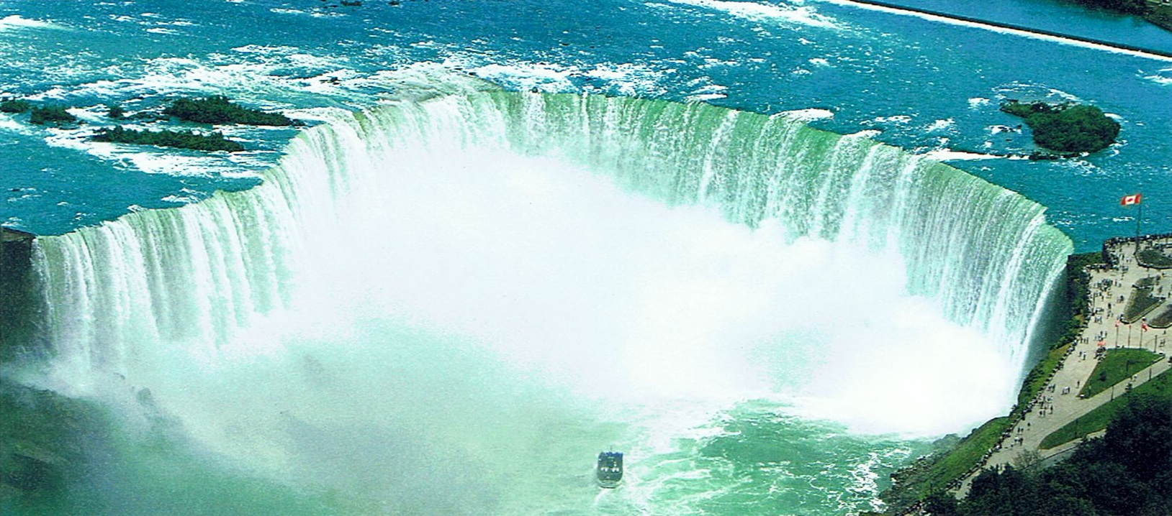
Velocity
Notes:
Velocity
Data Flow
Internet of things…
Streaming Data
Twitter – tweets per minute
Cerner for sepsis

Slide 16
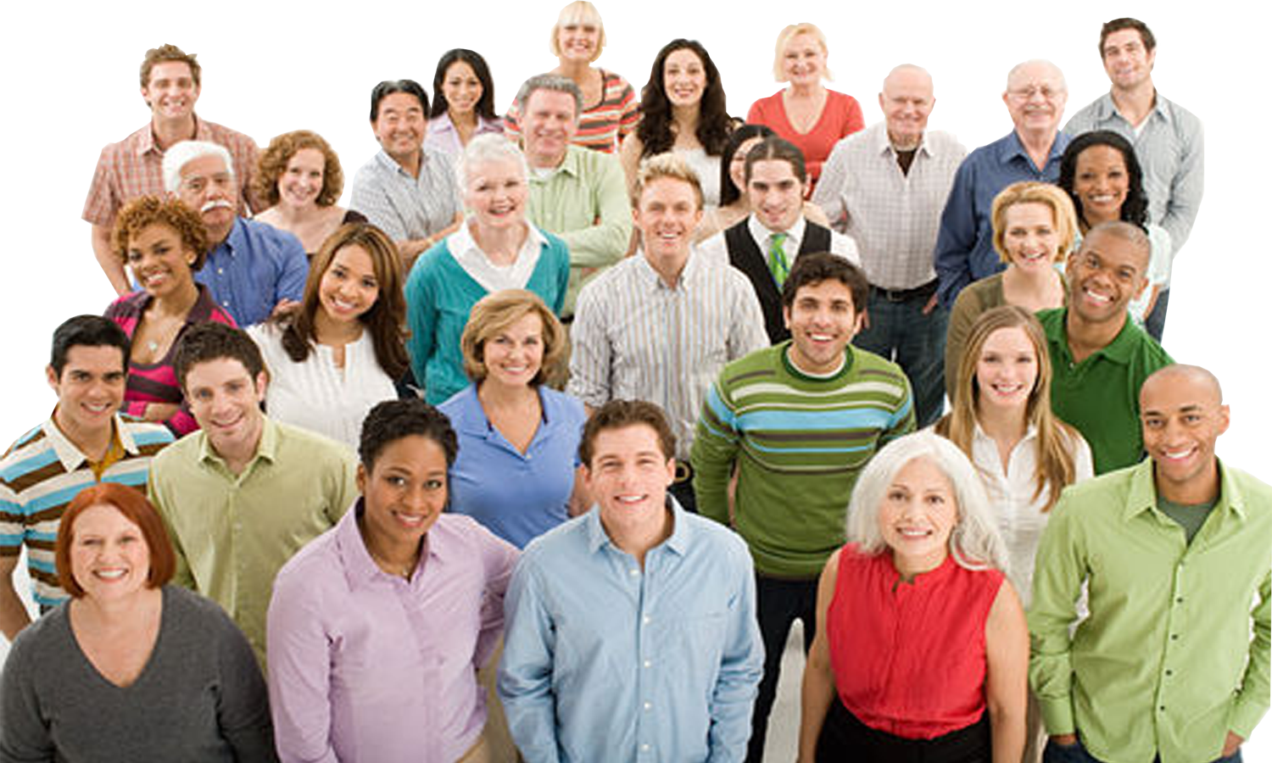
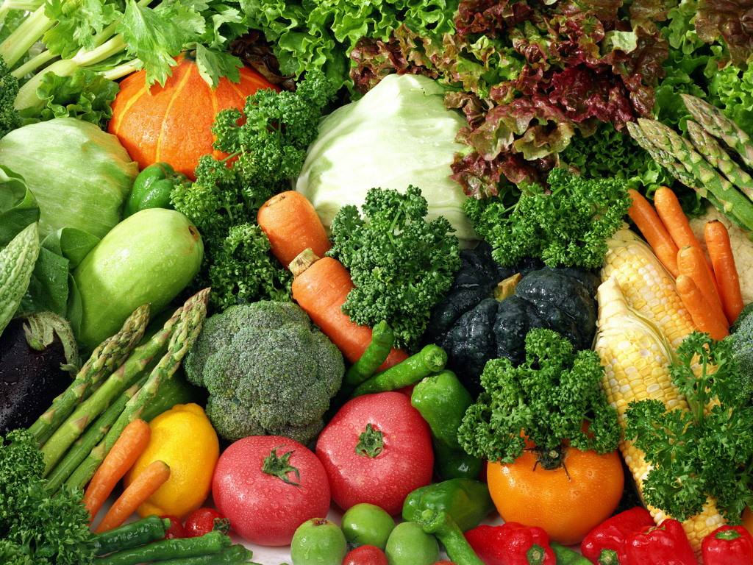
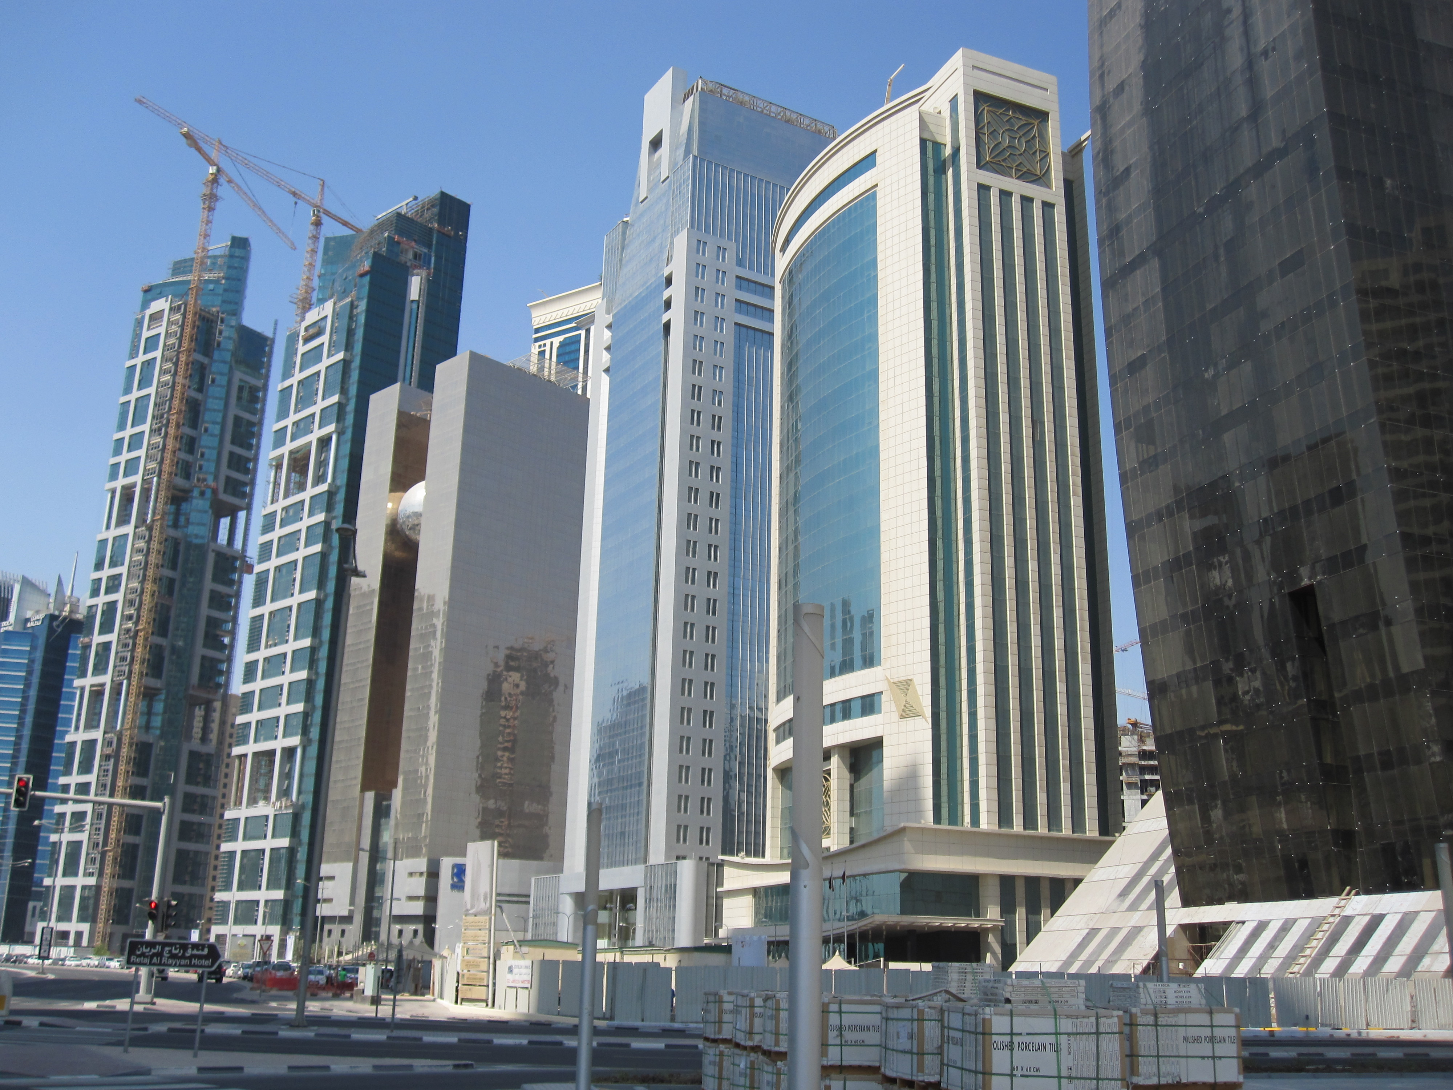
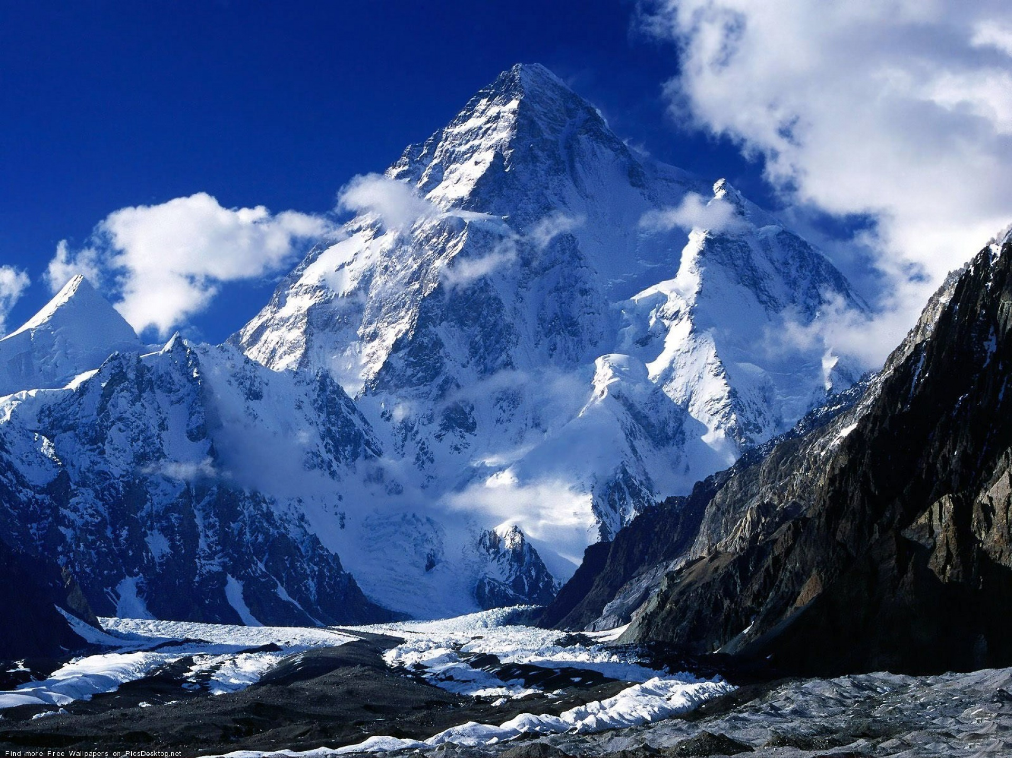
Variety
Notes:
Documents, Finances, Personal Files…
But now add photos, AV, 3d Models, Location Data
Can’t categorize -- unstructured

Slide 17
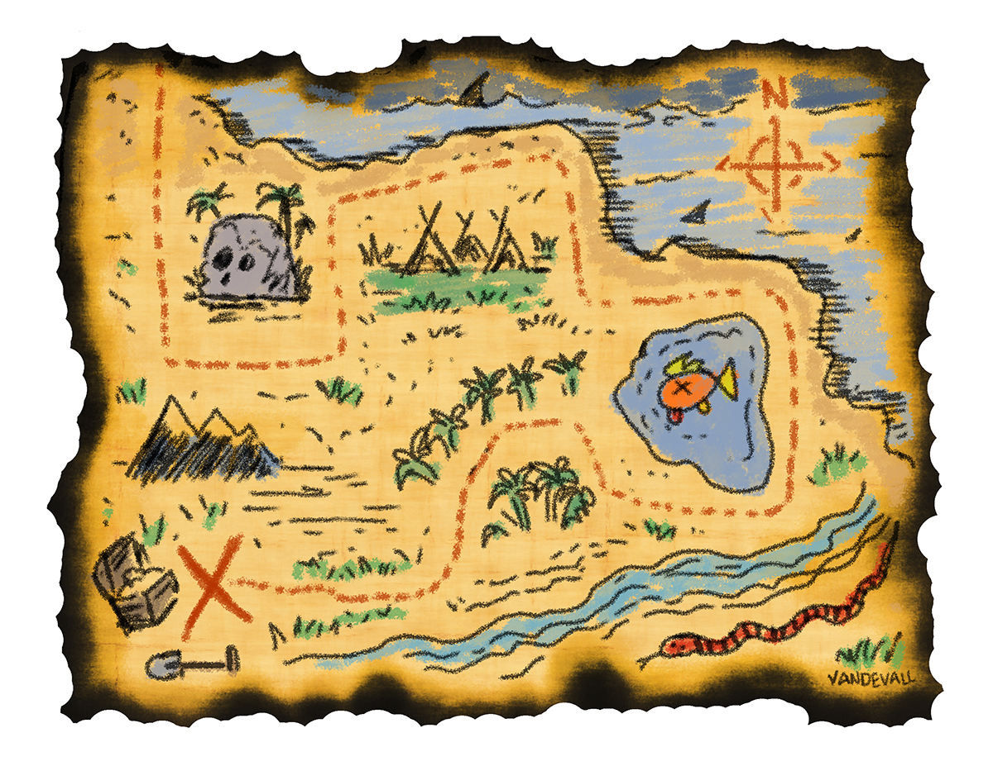
Map Reduce
Notes:
Google Developed
Hadoop is the open source version of MapReduce
Map Step
Split the Data and PreProcess
Reduce Step
Aggregate the results

Slide 18
Map Reduce?

Slide 19

Notes:
What is Hadoop?
Doug Cutting Nutch spider scrawler….
Open Source Version of Google’s Map reduce plus HDFS File system for managing the data.
3 Copies of everything.
All these servers have disk and CPU. So instead of pulling the data to the code, you push the code to the data

Slide 20


Notes:
Cloudera, Doug Cutting Co-Creator of Hadoop is the – Architect at Cloudera. He pulled some people with him.
The Original team was at Yahoo and they where spun off into Hortonworks

Slide 21
But it doesn’t end there….

Slide 22
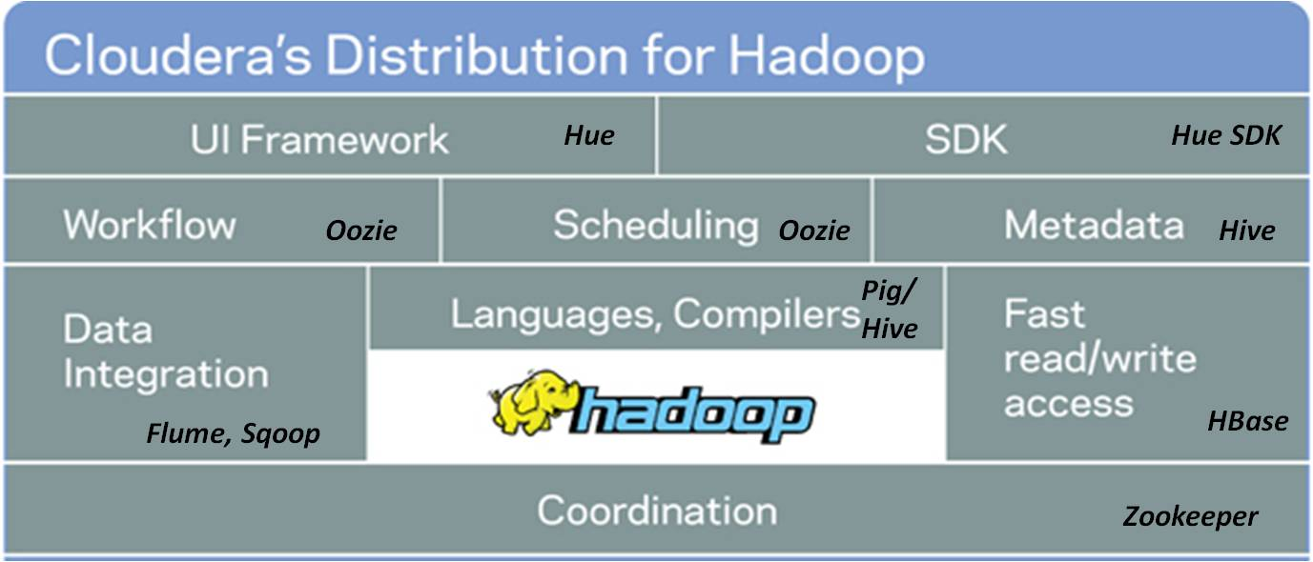

Slide 23
Hadoop vs NoSql
Notes:
Hadoop does data aggregation, nosql is for simple selects….

Slide 24
Why is it called NoSql?
Notes:
Johan Oskarsson in 2009 organizing an event

Slide 25
#

Slide 26
NoSql Characteristics
Non-Relational
Open-Source
Cluster Friendly
21st Century
Schema-less

Slide 28

Key/Value Store
MongoDB
Scalability
RDBMS
Functionality
Notes:
Vs RDBMS
Scaling Horizontally vs Vertically
RDBMS == High Functionality & Low Scalability | MongoDB == High Scalability & Moderate => High Functionality
Mongo Gives Up Joins & Transactions, because those are the two main things that scale poorly horizontally
No Constraints
No Schema
16mb document size limit.

Slide 29










Slide 30
Document
Column
Family
Graph
Key Value
Notes:
HBAse is BIG Table

Slide 31
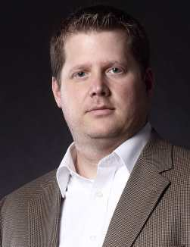
Key-Value
Jmills37
Information….
Password, Preferences, etc…..

Slide 32
Column Family
Jmills37
Jmills37
Security
Preferences
Password: sfjs;ofjsdo;jf
Last Login: 1/27/14
Trusted Devices: XXXXX
Screen Orientation: L
Favorite Stories: adsodkfjsdot
Contact Preference: Push
Notes:
Keep like items on the same instance

Slide 33

Document

Slide 34
Document

Slide 35
Document
{
"_id": {
"$oid": "515d9885e4b035b7009ddc1c"
},
"id": 9948,
"name": "Managing Developers",
"level": 100,
"length": "1 Hour",
"synopsis": “",
"room": 2207,
"slot": "Saturday 9:40",
"speakerName": "Jonathan Mills",
"speakerId": 9912
}
Notes:
Refferential Integrity
No Schema / Implied Schema

Slide 36
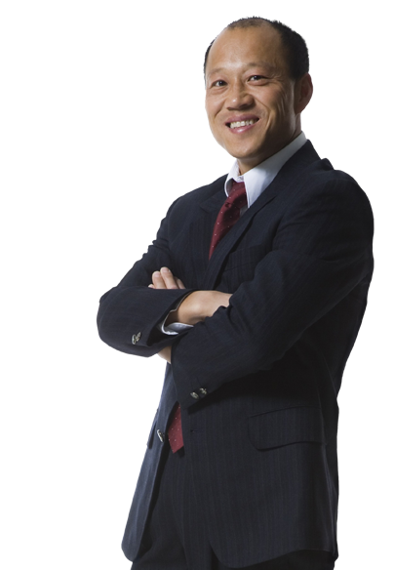
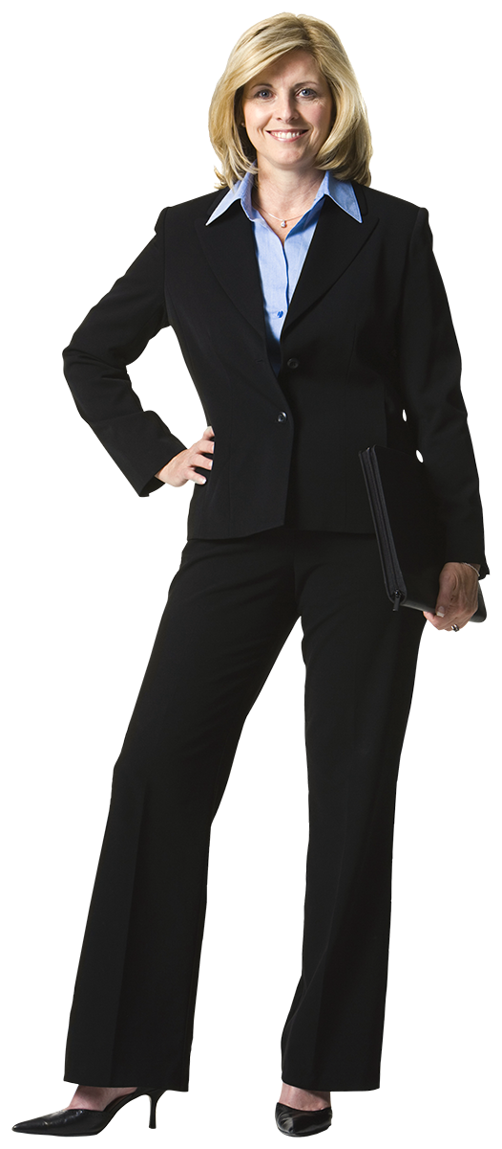


Graph DBS
Worked With
Dave
Works With
Susan
Works With
Tracy
Mark

Slide 37
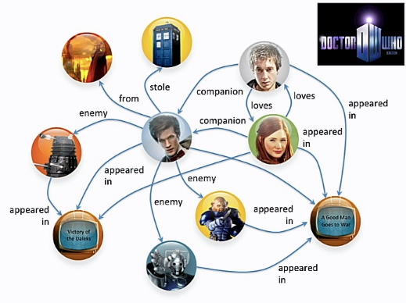
Graph DBS

Slide 38
Document
Column
Family
Graph
Key Value

Slide 39
Document
Column
Family
Graph
Key Value

Slide 40
Document
Column
Family
Graph
Key Value

Slide 41


Why Would I Do This?
Customer Insight

Slide 42
What Is The Next Netflix Series?
Political Dramas
British Shows
Kevin Spacey
David Fincher
Notes:
David Fincher – Alien3, Seven, The Girl With The Dragon Tattoo, Zodiac, The Game….

Slide 43
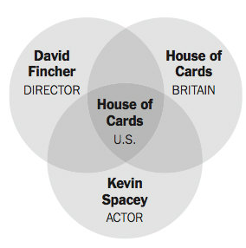
House Of Cards?

Slide 44
Why Would I Do This?
Customer Insight
Forecasting trends

Slide 45
Why Would I Do This?
Customer Insight
Forecasting trends
Healthcare trends

Slide 46
Why Would I Do This?
Customer Insight
Forecasting trends
Healthcare trends
Closer To Home….

Slide 47
Why Should I Care?
Evade The Hype…..

Slide 48
Don’t start with the data….
Start with a need… use data as a solution.

Slide 49
Why Should I Care?
Is your data really big?
Does the insight your data could provide really matter?
Are you ready for the volume you will get if you collect it?

Slide 50
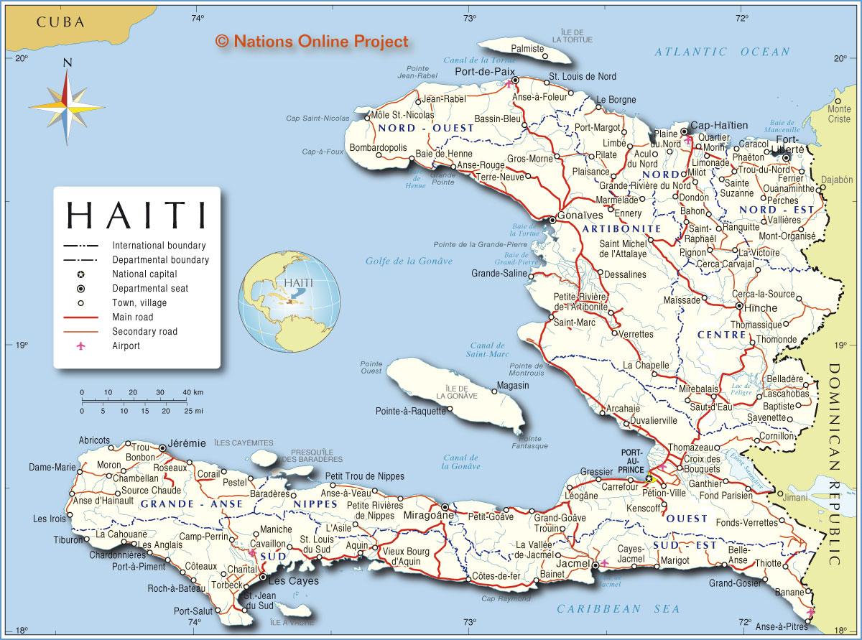
Be a Skeptic

Slide 51
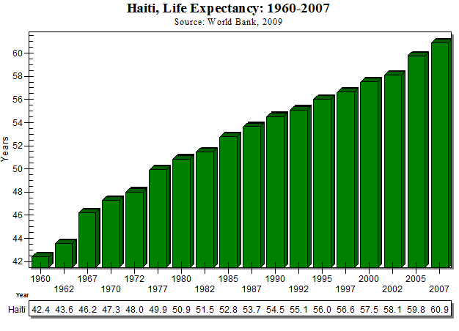
Notes:
The data was not flawed. The assumptions based on the data was bad.

Slide 52
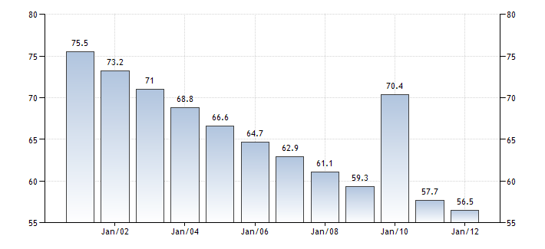

Slide 53
Notes:
The data was not flawed. The assumptions based on the data was bad.

Slide 54
Questions?

Slide 55
Who Is This Guy?
Research and Development \
Paige Technologies
@jonathanfmills
Jonathanfmills.com
Notes:
A little about me
As a manager, I should not have to supervise the work of others……
As a manager, I am responsible for making the team the most efficient team they can be
Over the long term… Sticks don’t work over long term
Make sure they want to come to work every morning
Make sure they feel appreciated.

